Slide 1
Learning in Neural Networks
Gradient Descent and Backpropagation

Slide 2
Learning in Neural Networks - two ingredients
Arbitrarily complicated functions can be optimized using Gradient Descent
An iterative algorithm that only depends on being to calculate the local gradient
With Neural Networks, the way we compute gradients of our Loss function is known as the Backpropagation Algorithm

Slide 3
Gradient Descent

Slide 4
Optimization
Training neural networks is achieved by finding the model parameters which minimize our designated Loss function
Loss functions
Remember, we get to choose this for our problem, but it is generally a measurement of how well our model is able to predict the actual observations. Might be squared-error loss for a regression task, might be cross-entropy for a classification task.
Model parameters
These are the weights of the neural network. The generally don’t have interpretable meaning, unlike in Linear Regression.
Think of these are “tuning knobs” - depending on the setting of the knobs, a neural network can emulate many different functions. Our goal is to the find the setting that best captures relationships seen in our actual observations.

Slide 5
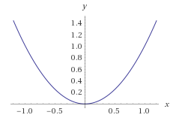
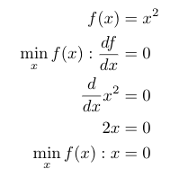
Optimization
Finding the optima of a function - where the derivatives are zero

Slide 6
Optimization
What if we have no analytical form for our function? We only have the ability to evaluate it for any given input X, what can we do?
And we certainly don’t have an analytical form of the derivative (or gradients) for the whole function space. But we could compute the gradient at a particular location X.
We’re going to follow the same intuition as before - we want to find locations where the gradient is zero (or very close).
We won’t be able to calculate it in one step as before. But instead we will iteratively search for locations with zero gradient. And until we’ve found such a location, we keep looking.

Slide 7
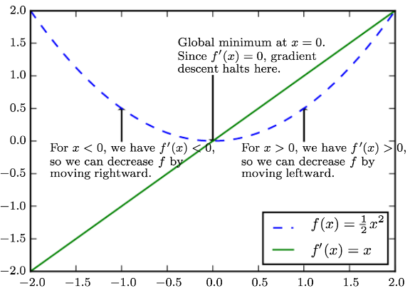
Gradient Descent
Here is our familiar function f(x)=x^2 (blue)
And we happen to know its derivative (green)

Slide 8
Gradient Descent
For any given location x, we evaluate the derivative f’(x)
If we move in the direction of the negative gradient, we know we will arrive at a new x which closer to the minimum of f(x) and not farther away.

Slide 9
Gradient Descent
Example:
We start at x=1.0
The derivative here is f’(1)=+1
We move in the direction of the negative gradient (we walk downhill). We move in the direction of - f’(1) = -1
So we move the direction of smaller x (leftward). And we would move toward the minimum.

Slide 10
Gradient Descent
Example:
We start at x=-1.0
The derivative here is f’(1)=-1
We move in the direction of the negative gradient (we walk downhill). We move in the direction of - f’(-1) = -(-1)
So we move the direction of larger x (rightward). And we would move toward the minimum.

Slide 11
Gradient Descent
If we take very small step sizes, we can get from any x to a point very close to the minimum of f(x)
Small step sizes are important so that we don’t start walking back up the hill on the other side

Slide 12
Exercise
You’re going to code up the previously described gradient descent algorithm for this simple function.
The function we are trying to optimize is f(x) = ½ x^2
Write a main function grad_descent(x_0, iterations, stepsize) that takes in an initial starting point, number of iterations, and stepsize parameters.
Write a helper function grad_f(x) that takes in a value of x and returns the gradient of our function at that x. (we already know f’(x)=x in this example function)
Your main function should call your helper function many times. Each time, you get a calculation of the gradient, then you decide where to move next (using the gradient direction and the stepsize), and then you update x.
Your main function should terminate after the proper number of iterations and then return the current location of x (the estimated minimum of f(x)).

Slide 13
Exercise
Things to think about when you’re done
The step size - what happens when it is too big or too small?
The number of iterations - what happens when this is too big or too small? What would be another way to decide when the algorithm should stop?
Notice that at each location x, we just need to calculate or lookup the gradient at x. In fact, this separation-of-duties of made clear by hiding away all the gradient calculation code into a helper function.
So even if we don’t have a full analytical expression for f(x) or f’(x) over all x, if we can just calculate f’(x) for a single x at a time, we can walk down the gradient toward the optimum.

Slide 14
Applying Gradient Descent to ANNs
We are trying to optimize our loss function, which is a sum over all observations
For any particular values of model parameters (weights), we compute the total loss, and the gradient of loss at that location
We take a step in the direction of the negative gradient
We repeat this process until our loss function seems to be no longer decreasing

Slide 15
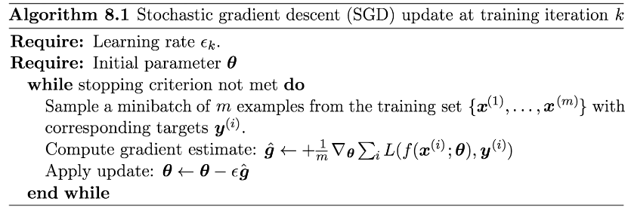
Stochastic Gradient Descent - General Algorithm
We now think about k different batches of data
We now have learning rate hyperparameter (similar to stepsize), doesn’t have to be constant.

Slide 16
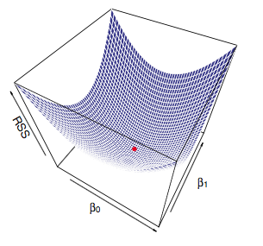
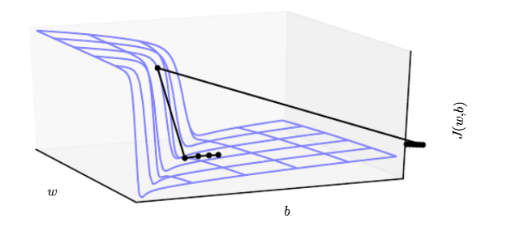
Loss Surfaces
Some loss surfaces are have “nice” geometries and optimization should be simple (convex optimization). With deep learning, we are optimizing highly non-convex surfaces composed of non-linear functions. These surfaces are not simple.

Slide 17
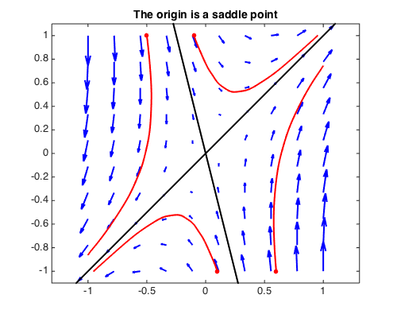
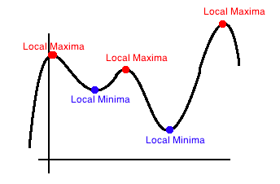
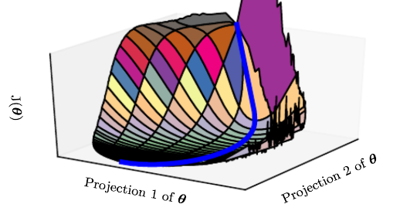
Challenging Loss Surfaces
Ill-conditioning
Local minima
Saddle nodes
Plateaus

Slide 18
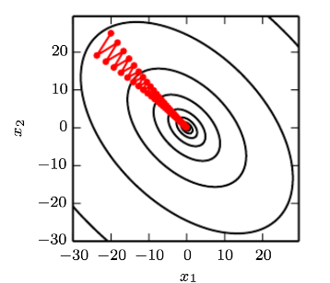
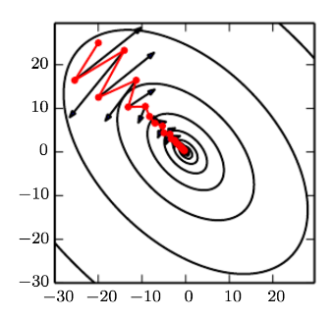
Momentum Methods
If curvature is stronger in some dimensions than others, the gradient is dominated by one direction, leading to oscillatory behavior. This is wasteful and also causes us to move very slowly in the other dimensions.

Slide 19
Momentum Methods
Methods that incorporate momentum seek to use not just the instantaneous gradient, but also the past gradients of previous locations visited.

Slide 20
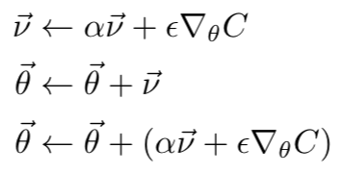
Momentum Methods
Keep track of a velocity vector that indicates the direction you were recently moving
Over time, the velocity vector sums up all the previous gradients
Now the update is not simply a step in the direction down the gradient
The update is a weighted sum of the gradient and the previous direction of motion

Slide 21
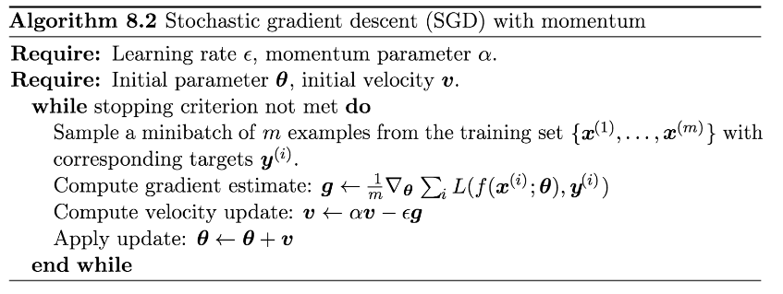
Momentum

Slide 22
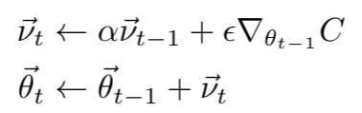

Momentum Methods
Momentum methods can be seen as creating an exponentially-weighted combination of all previous iterations.

Slide 23

Momentum Methods
Momentum methods can be seen as creating an exponentially-weighted combination of all previous iterations.
future
present
past

Slide 24



Momentum Methods
Momentum methods can be seen as creating an exponentially-weighted combination of all previous iterations.
future
present
past

Slide 25
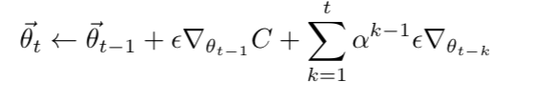
Momentum Methods
Momentum methods can be seen as creating an exponentially-weighted combination of all previous iterations.
future
present
past

Slide 26
Adaptive Methods
For now, we will focus on gradient descent and momentum. But many newer methods are used in practice, and these methods build upon the same principles but with adaptive learning rates and other innovations.
AdaGrad
RMSProp
Adam
You can read about them in section 8.5 of Goodfellow to gain familiarity. We won’t dive into their details, but you might leverage them when using Keras or Tensorflow.

Slide 27
Higher Order Methods
Methods that take into account the curvature of the Loss surface have the promise of more efficient optimization
However, estimating the curvature (Hessian matrix) is quadratic in the number of parameters. For large models, this is impractical.
Methods exist which aim to estimate curvature in linear time
Chapter 8 of Goodfellow walks through several such ideas. Familiarize yourself with these concepts, but this topic is rare in practice today and is beyond what we need to discuss.

